Slide 1
Student Performance Prediction
Prepared By :
M. Abdullah Khalid
Presented To:
Sir Saeed

Slide 2
INTRODUCTION:
This is my Classification project named (Student Performance Prediction). In which the project predicts that the student is going to be fail or pass by knowing these activities.
Free time
Travel time
Study time
Health Status

Slide 3

Data Set:
This data set has been taken from keggle.com which contains information about students’ academic performance and record of student.
This loads the data set of the Student’s accedemic performance .

Slide 4


Preprocessing Steps
Load the Dataset:
View First Few Rows:
Shows the first 5 rows to understand what the data looks like.
Check Data Info:
Displays the number of rows/columns, data types (like numbers or text), and if any values are missing.
Loads the student data from a CSV file .

Slide 5


Check for Missing Values
Tells how many missing (empty) values are in each column.
Drop Missing Values
Removes rows that have any missing values (if they exist).

Slide 6
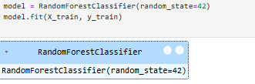
Modeling
Imagine you are giving data about students:
X_train = Information about students like study time, age, travel time, etc.
y_train = Whether the student passed (1) or failed (0) in the final exam.

Slide 7
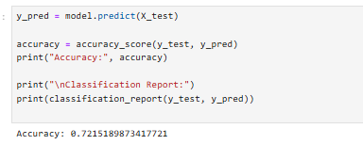
Evaluation
Accuracy_score(y_test, y_pred) compares the actual values (y_test) with the predicted ones (y_pred) and gives you the overall accuracy.
For example, if 85 out of 100 predictions were correct, the accuracy will be 0.85 (or 85%).

Slide 8
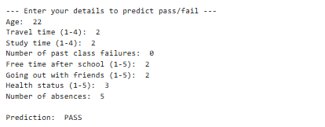
Conclusion
In the end I would like to say that this project predicts the student performance in studies by input the following details .
Age
Travel time
Study time
Number of past class failures
Free time after school
Going out with friends
Health status
Number of absences

Slide 9
Thank you

